Slide 1


What's PhD Research?
Michele C. Weigle and Michael L. Nelson
CS 891 – Web Archiving Seminar
Fall 2017
Largely based on "What's Grad School All About?", https://www.slideshare.net/mweigle/2015-cap-wic
@WebSciDL
https://phonedude.github.io/cs891-f17/

Slide 2
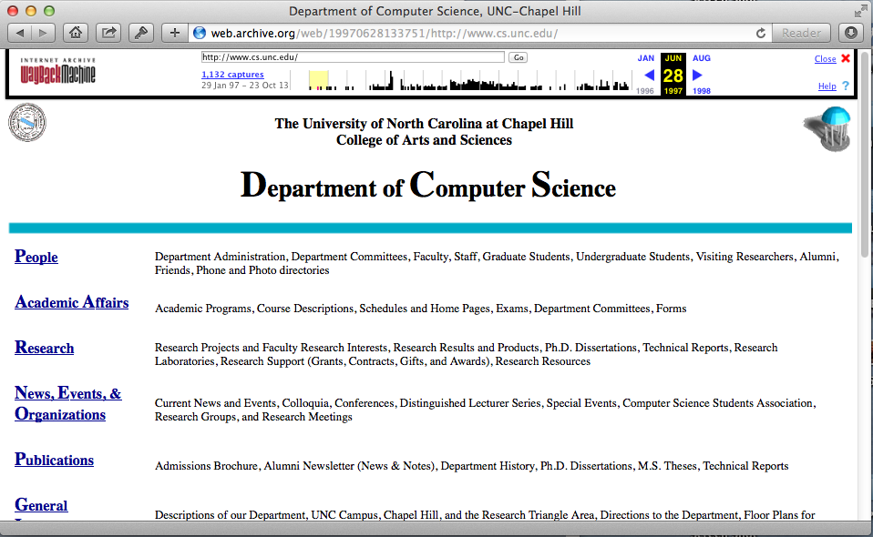
UNC-CS

Slide 3
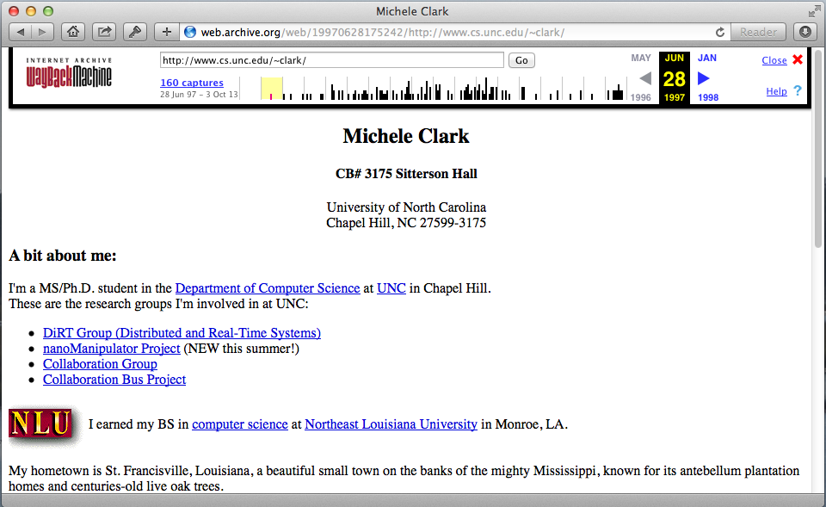
My CS Homepage - 1997

Slide 4
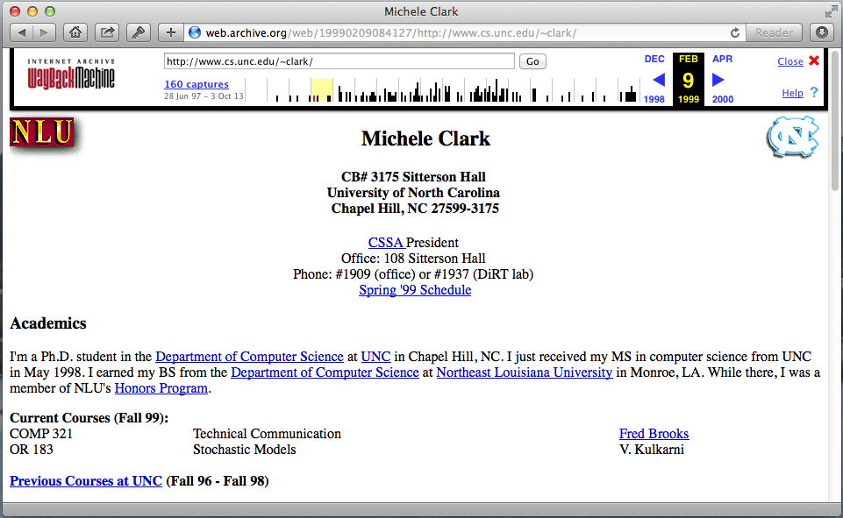
CS Student Assoc Pres - 1999

Slide 5
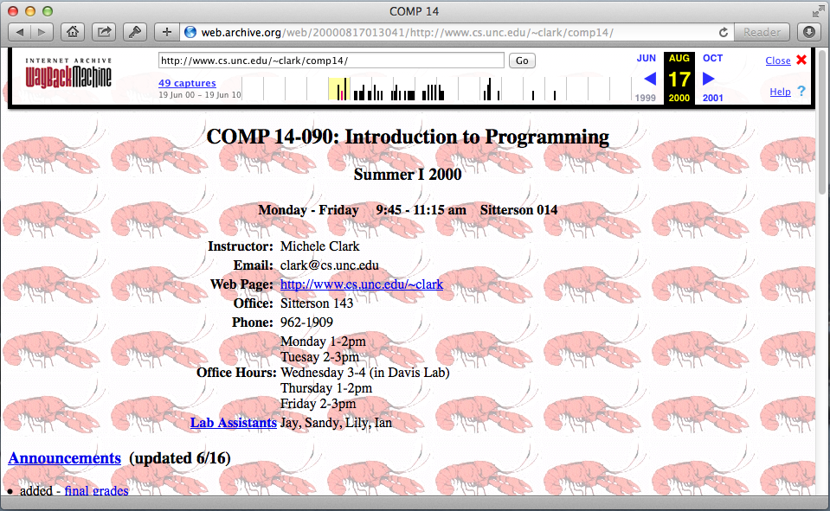
Teaching - 2000

Slide 6
Grad School
I loved grad school
and I love it even more now that I can look back fondly on it
No "real-life" responsibilities
single, no kids, no house
Developed life-long friendships
Met people from all over the world
Worked with really smart people
Worked on interesting projects
Got to code!
Attended interesting (sometimes!) classes
Got to travel (for free) - Italy, Sweden, Lake Tahoe, Norfolk

Slide 7
MS vs PhD - Jobs
A masters degree equips you to do high level, complex design and potentially lead software engineering teams.
A PhD degree equips you to do original research and potentially lead R&D teams.
“With a Ph.D. you will have a better chance of spending the rest of your life doing what you want to do, instead of what someone else wants you to do."
William Lipscomb, a Nobel Prize winner in chemistry
http://www.quora.com/What-are-the-main-differences-between-a-Masters-and-a-PhD-in-computer-science
Vijay Chidambaram, computer science grad student

Slide 8
MS vs. PhD – Requirements at ODU
MS
34 hours of coursework (11 courses)
project (only 10 courses) or thesis (only 8 courses)
usually partial tuition waiver
~2 years
PhD (after MS)
48 credit hours
24 hours of coursework (8 courses)
4 "real" courses (not seminar or special topics) with 3 different faculty members
24 hours of dissertation credits
full tuition waiver
variable (often 3-5 years after MS)

Slide 9
BS vs. MS vs. PhD
BS - you are given the questions and the answers
MS - you are given the questions and mostly you get to find the answers
PhD – you must come up with the questions and the answers
It sure is a lot simpler when you are given the questions and the answers.
Dr. Kris Cooper (my undergraduate advisor)

Slide 10
A PhD is All About Questions
"A PhD teaches you how to ask the right questions"
Your PhD advisor's job is to ask questions about your work
why does the output/graph/result look like this?
what would happen if you ran the experiment/analysis another way instead?
http://blog.skanev.org/2013/03/why-not-do-phd-in-computer-science.html

Slide 11
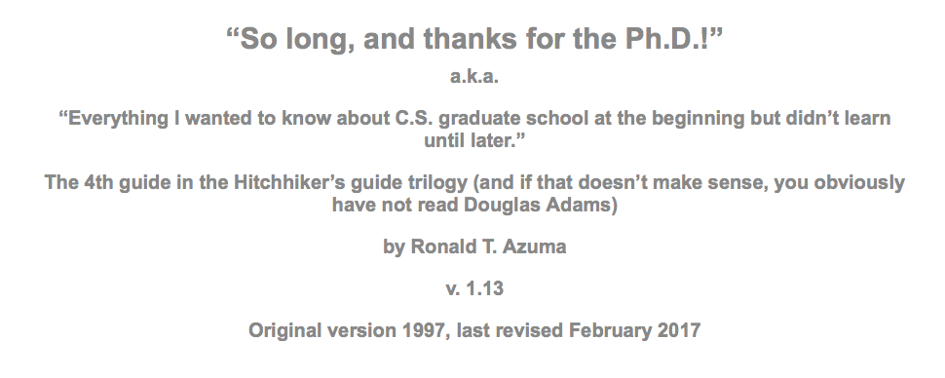
So long, and thanks for the PhD!
Ron Azuma's classic article (PhD, UNC 1995)
http://www.cs.unc.edu/~azuma/hitch4.html

Slide 12
What is a PhD?
A PhD program is very different from getting a Bachelor’s degree, and you must treat it as a strange type of job.
Initiative, tenacity, flexibility, interpersonal skills, organizational skills, and communication skills are all critical and not things that universities typically test for in selecting incoming students.
A PhD is a means to an end: employment in a startup, commercial business, government or industrial research lab, or academia.
http://www.cs.unc.edu/~azuma/hitch4.html

Slide 13
Where do GRAs Come From?
Academia is a business, and “graduate student” is a job title.
Faculty write grant proposals to external agencies (NSF, NEH, IMLS, …).
fund GRA stipends, travel, small amounts of faculty summer support
without grant funding, there is no GRA funding
These agencies expect concrete deliverables (software, publications, etc.).
My chances of future funding are largely based on your performance.
http://www.cs.unc.edu/~azuma/hitch4.html

Slide 14
Treat Your GRA Like a Job
You must prove to your professors that you are capable of
getting the work done,
being a team player,
communicating your results, and
most of the other characteristics needed to do well in regular jobs.
http://www.cs.unc.edu/~azuma/hitch4.html

Slide 15
A PhD is Not About Courses
Most of what you learn in a Ph.D. program comes outside of classes:
from doing research on your own and in collaboration with your advisor
attending conferences
discussions with your fellow students
http://www.cs.unc.edu/~azuma/hitch4.html

Slide 16
Ph.D. Students Must Break Away From Undergraduate Mentality
Grades don't matter much anymore
main form of evaluation is research progress (i.e., publications)
There is no one who can tell you exactly what to do, so own your research
secret: your advisors don't know all the answers!
When you graduate, you will be the world's expert on your dissertation topic
https://cacm.acm.org/magazines/2013/7/165494-ph-d-students-must-break-away-from-undergraduate-mentality/fulltext

Slide 17
Critical Skills Needed
Initiative
Tenacity
Flexibility
Interpersonal skills
Organizational skills
Communication skills
http://www.cs.unc.edu/~azuma/hitch4.html

Slide 18
Initiative
The dissertation represents a focused, personal research effort where you take the lead on your own, unique project.
Ph.D. students must show initiative to successfully complete the dissertation.
If you never do any tasks except those that your professor specifically tells you to do, then you need to work on initiative.
http://www.cs.unc.edu/~azuma/hitch4.html

Slide 19
Tenacity
No one can tell you in advance exactly how long the dissertation will take, so it’s hard to see where the “end of the road” lies.
You will encounter unexpected problems and obstacles that can add months or years to the project.
If you are not tenacious about working on the dissertation, you won’t finish.
The best way to finish the dissertation is to do something every day that gets you closer to being done.
http://www.cs.unc.edu/~azuma/hitch4.html

Slide 20
Flexibility
Flexibility means
taking advantage of opportunities and synergies,
working around problems
being willing to change plans as required
http://www.cs.unc.edu/~azuma/hitch4.html

Slide 21
Interpersonal Skills
You need to build and maintain interpersonal relationships with your advisor, your committee, your research and support staff and your fellow students.
Cultivating interpersonal relationships is mostly about treating people with respect and determining their different working styles.
Give credit where credit is due.
Acknowledge and thank them for their help.
Return favors.
Respect their expertise, advice and time.
Apologize if you are at fault.
Realize that different people work in different ways and are motivated by different things
http://www.cs.unc.edu/~azuma/hitch4.html

Slide 22
Organizational Skills
You will have lots of responsibilities (classes, GRA, GTA, dissertation research, publications)
You must be well-organized and learn to prioritize to make sure the important things get done
Additional time management advice from Randy Pausch (former prof at UVa, CMU) http://web.archive.org/web/20070223065627/www.cs.virginia.edu/helpnet/Time/time.html
http://www.cs.unc.edu/~azuma/hitch4.html

Slide 23
Communication Skills
You will write (a lot)
You will present your ideas (a lot)
It will be so much better (and more efficient) for all of us if we spend more time talking about research ideas than about organization, grammar, and typos
I cannot over-emphasize how important this is
This is so important that we'll have a whole set of slides/discussion a bit later in the semester
http://www.cs.unc.edu/~azuma/hitch4.html

Slide 24
Surviving the PhD
Read Ron Azuma's guide
Perseverance
it can be slow, it can get boring, some days you just have to get through it
Initiative
your advisor will rarely bug you each day to make sure you're working, must set your own goals
Curiosity
PhD students are usually ready to graduate once they start asking their own questions about their data and research
Coffee

Slide 25
What is Research?
Matt Might (http://matt.might.net/), a professor in Computer Science at the University of Utah, created "The Illustrated Guide to a Ph.D." to explain what a Ph.D. is to new and aspiring graduate students.
[Matt has licensed the guide for sharing with special terms under the Creative Commons license.]
http://matt.might.net/articles/phd-school-in-pictures/

Slide 26

Imagine a circle that contains all human knowledge
http://matt.might.net/articles/phd-school-in-pictures/

Slide 27

By the time you finish elementary school, you know a little
http://matt.might.net/articles/phd-school-in-pictures/

Slide 28
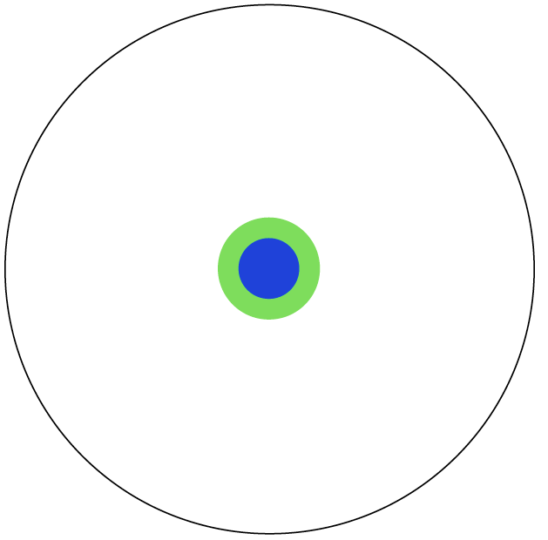
By the time you finish high school, you know a bit more
http://matt.might.net/articles/phd-school-in-pictures/

Slide 29
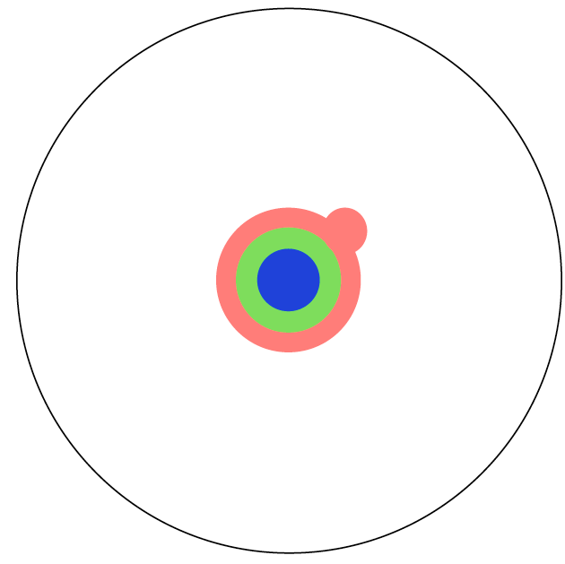
With a bachelor's degree, you gain a specialty
http://matt.might.net/articles/phd-school-in-pictures/

Slide 30

A master's degree deepens that specialty
http://matt.might.net/articles/phd-school-in-pictures/

Slide 31
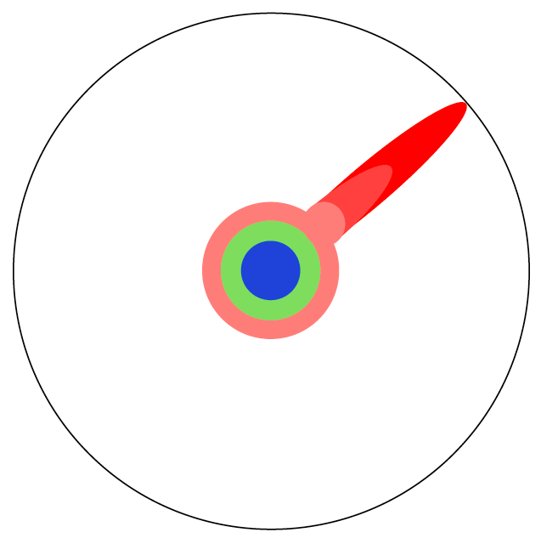
Reading research papers takes you to the edge of human knowledge
http://matt.might.net/articles/phd-school-in-pictures/

Slide 32
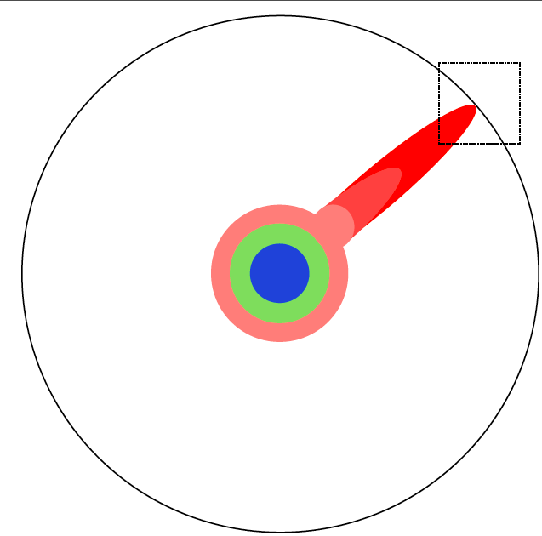
Once you're at the boundary, you focus
http://matt.might.net/articles/phd-school-in-pictures/

Slide 33

You push at the boundary for a few years
http://matt.might.net/articles/phd-school-in-pictures/

Slide 34

Until one day, the boundary gives way
http://matt.might.net/articles/phd-school-in-pictures/

Slide 35
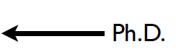
And, that dent you've made is called a Ph.D.
http://matt.might.net/articles/phd-school-in-pictures/

Slide 36

Of course, the world looks different to you now
http://matt.might.net/articles/phd-school-in-pictures/

Slide 37

So, don't forget the bigger picture
Keep pushing.
http://matt.might.net/articles/phd-school-in-pictures/

Slide 38
Skills Gained Through PhD
Ability to work independently
Critical thought
A PhD candidate learns to critically examine the thoughts of others and pick out the pros and cons.
Perseverance
Ability to work with poorly defined goals
One of the bigger hurdles of the PhD is that there is no clear cut goal.
No one can exactly say these are the things you need to do every day.
Research as such involves going back and forth, exploring blind alleys and so forth.
Effective communication
http://www.quora.com/What-are-the-main-differences-between-a-Masters-and-a-PhD-in-computer-science
Vijay Chidambaram, computer science grad student

Slide 39
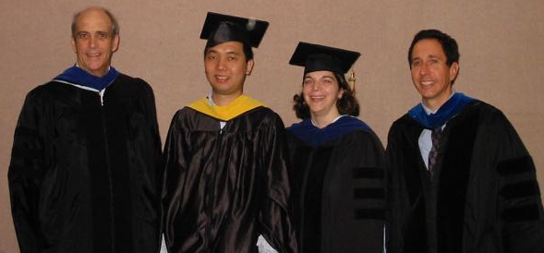
Why Did I Want to Become a Professor?
Inspired by mentors and undergraduate/graduate faculty
Liked teaching
really enjoy learning something new, organizing the information, and figuring out the best way to present it
Flexibility
can choose own research topics (to some extent)
my advisor coached his son's soccer team
I loved being a graduate student and didn't want to leave academia

Slide 40


Clemson
Assistant Professor - 2004-2006
Students investigated high-speed TCP protocols and Internet traffic generation for simulations
2 MS theses
Started investigation of vehicular networks
using PocketPC and Bluetooth GPS devices
Teaching networking courses
ugrad - network programming
grad - network protocols

Slide 41
ODU
2006 - Joined as Assistant Professor
2012 - Tenure, promoted to Associate Professor
2013 - Graduate Program Director
2018?? – Promoted to Full Professor
Vehicular networks, sensor networks, web science, digital preservation, information visualization
in chronological order

Slide 42
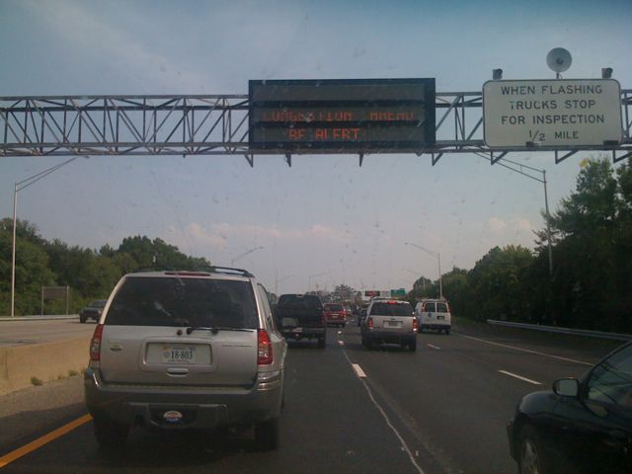
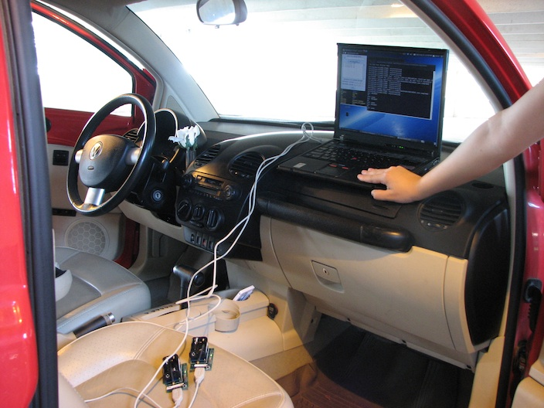
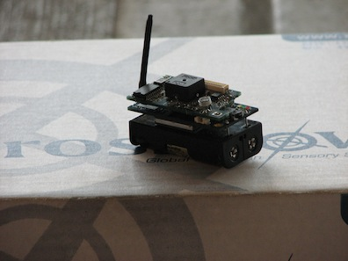
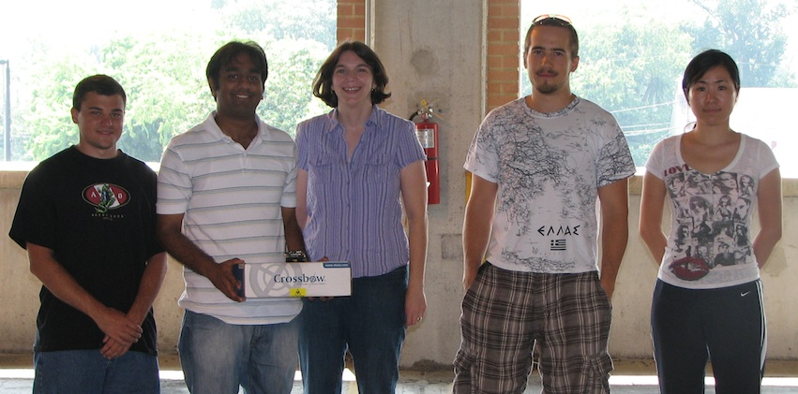

Vehicular Networks - NOTICE Project
An Architecture for the Notification of Traffic Incidents and Congestion (NOTICE), National Science Foundation, 2007-2012, $400,000

Slide 43
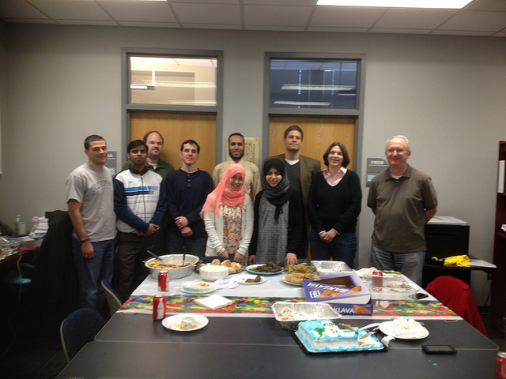


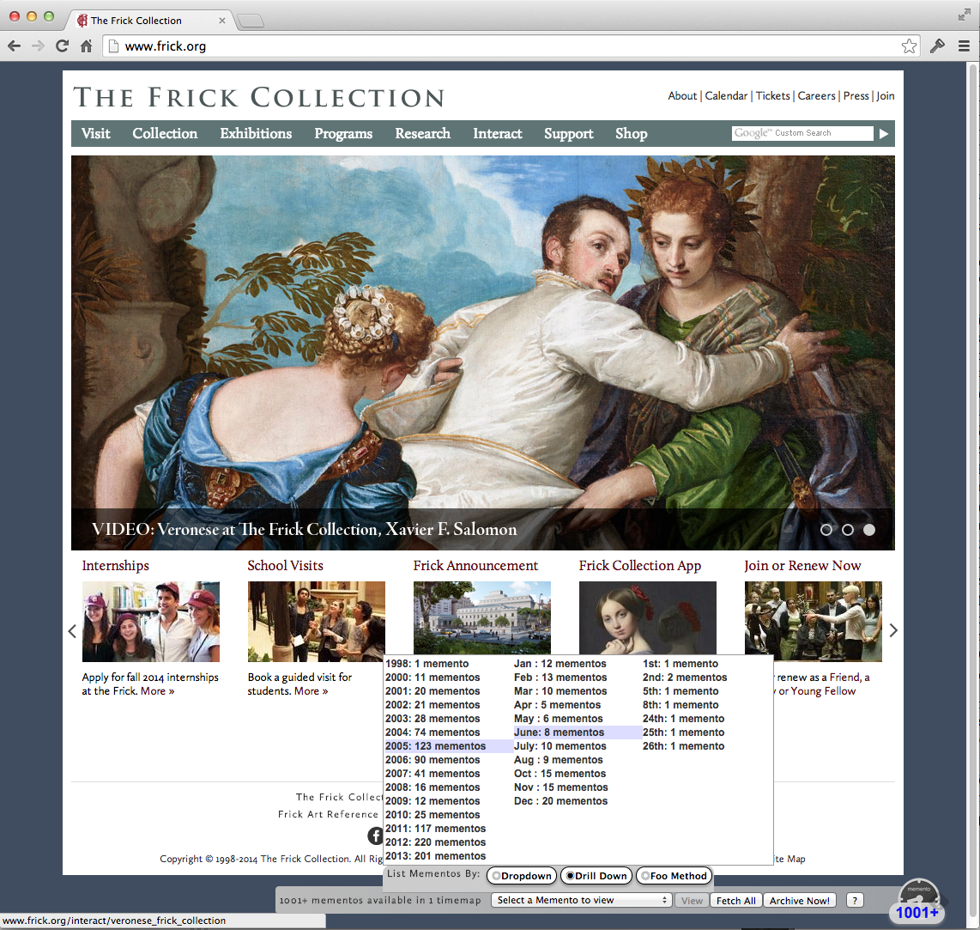

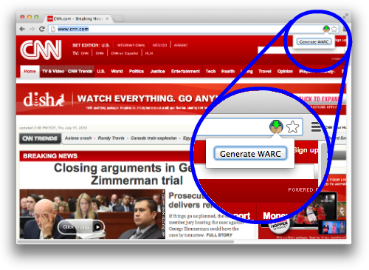




Web Science and Digital Libraries
Mink
WARCreate
Archive What I See Now: Bringing Institutional Web Archiving Tools to the Individual Researcher, Digital Humanities Implementation Grant, 2014-2017, $325,000

Slide 44
Information Visualization

Slide 45
Perks of Academia
Work with really smart people
faculty colleagues
students
Always learning new stuff
research
teaching courses
Control your own destiny
no one's looking over your shoulder to see if you're in your office 9am-5pm
change research projects and focus

Slide 46
Academia Isn't the Only Option

